Slide 1
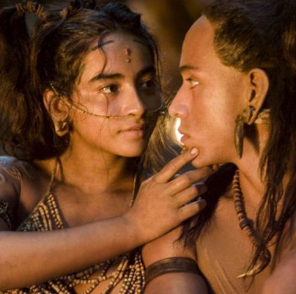
From prehistoric love to dating apps: Sexual selection and mutual mate choice for language
Geoffrey Miller, Ph.D.
Associate Professor of Psychology
University of New Mexico, USA

Slide 2
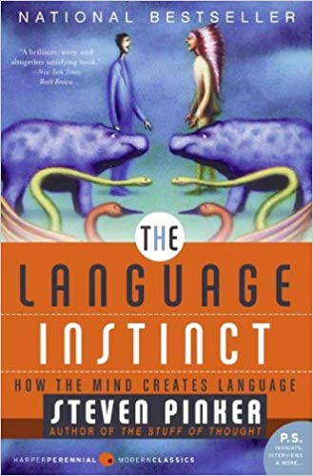
Human language is an evolved adaptation – but what was its main adaptive function? Most ‘theories of language evolution’ do not identify specific survival or reproductive benefits to individual speakers

Slide 3
Thousands of species use vocal signals to attract mates

Slide 4
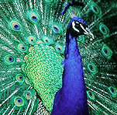
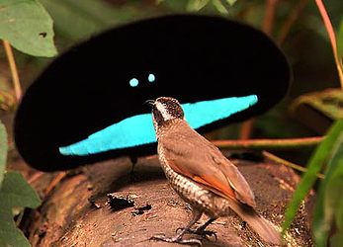
Vocal signals are often ‘fitness indicators’
Most animal species evolve ‘fitness indicators’ (sexual ornaments, trait signals)
traits that display good genes, good health, & good brains
adaptive function: attract & retain sexual mates
Peacock
Superb Bird of Paradise

Slide 5
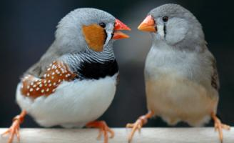
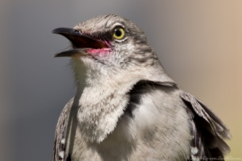
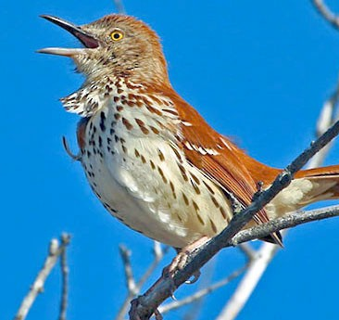
Bird song as a fitness indicator
Problem-solving intelligence predicts song repertoire size, which is sexually attractive
song sparrow (Boogert et al., 2001)
zebra finch (Boogert et al., 2005)
mockingbird (Botero et al., 2009)
Mate choice favored very large song repertoires in some species
brown thrasher has over 1,100 distinct song-types (Boughey & Thompson, 1981)
Most of the complex vocal signals in other species are sexually selected fitness indicators

Slide 6
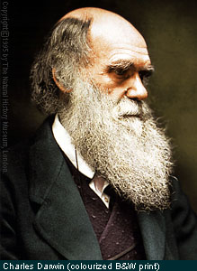
Inspired by Darwin (1871) The Descent of Man
I’ve argued since 1992 that human language evolved partly
through mutual mate choice
by both males and females
as a reliable indicator of intelligence & creativity
to attract mates, keep mates, & coordinate behavior in long-term pair bonds

Slide 7
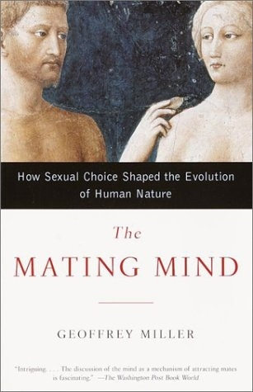
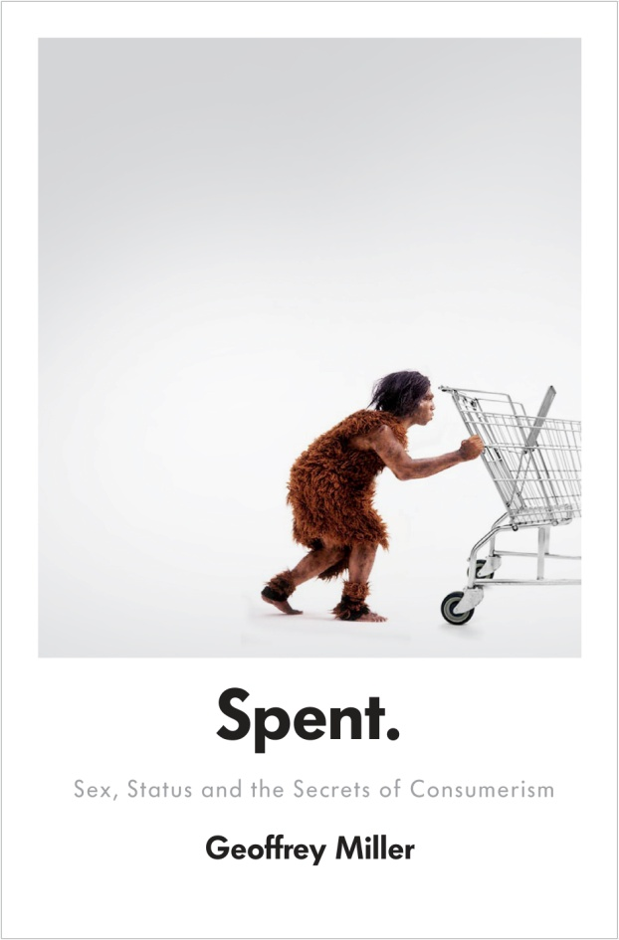
Sexual selection for mental traits
2000
2007
2009
2016
2019
This power point is available at www.primalpoly.com/talk-powerpoints

Slide 8
Signaling in other animals
Good genes
Good body
Good brain
signaller
receiver

Slide 9
Signaling in humans
Good genes
Good body
Good brain
signaller
receiver

Slide 10
Signaling with mutual mate choice
Good genes
Good body
Good brain
signaller & receiver
signaller & receiver

Slide 11
Signaling through mental fitness indicators
Intelligence
Creativity
Music, Art, Humor
Moral Virtues
Language Abilities
signaller & receiver
signaller & receiver

Slide 12
Signaling through chat apps & dating apps
signaller & receiver
signaller & receiver

Slide 13
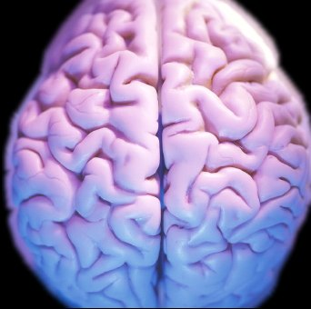
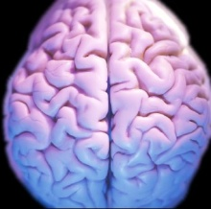
Mutual mate choice for mental ‘fitness indicators’
humor story-telling entertainment
Babies with better genes and brains

Slide 14
Language ability shows (at least) 6 features of sexually-selected traits:
sexual attractiveness to potential mates
conspicuous display during verbal courtship
more costly & complex than it needs to be
life-span development resembles other sexually-selected traits
positive heritability, & mutation load effects that reveal genetic quality
positive genetic correlations with general intelligence, mental health, & physical health

Slide 15
1. Language ability is sexually attractive
Across cultures, the most attractive traits include intelligence, humor, communication skills (Lippa, 2007, N=218,195)
Bigger vocabulary size is attractive to women (Prokosch et al., 2009)
In dichotic listening task, ovulating women are more sensitive to complex verbal courtship (Rosen & Lopez, 2009)

Slide 16
1. Verbal humor is especially attractive
Spontaneous verbal humor is attractive (Bressler & Balshine, 2006; Greengross & Miller, 2008; Kauffman et al., 2007; McGee & Shevlin, 2009)
Memorized ‘pick up lines’ & jokes are not attractive (Bale et al., 2006)
General intelligence predicts verbal humor ability, which predicts mating success (Greengross & Miller, 2011)
Males show higher average verbal humor ability (Greengross et al., 2020: meta-analysis of 28 studies, N=5,057, d = .32)

Slide 17
2. Language abilities are displayed during courtship
Story-telling, public speaking, humor, & love poetry are sexual ornaments (Burling, 1986; Dessalles, 1998; Miller, 2001; Locke 2011; McKeown, 2013)
Men talk more about intellectual topics when women are nearby (Dunbar et al., 1997)
Mating-primed people show more verbal creativity (Griskevicius et al., 2006)
Mating-primed males use rarer words (Rosenberg & Tunney, 2008)
Mating-primed listeners expect extra cognitive effort from speakers (Franks & Rigby, 2005)

Slide 18
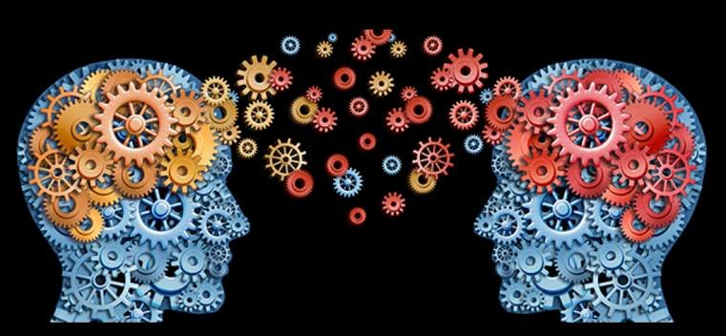
3. Language is more costly & complex than it needs to be
Language is very efficient in some ways
Principle of Least Effort, Zipf’s Law (Kanwal et al., 2017)
But verbal courtship often shows ornamental levels of cost, complexity, and precision
vocabulary size
syntactic complexity
fictional story-telling
humor

Slide 19
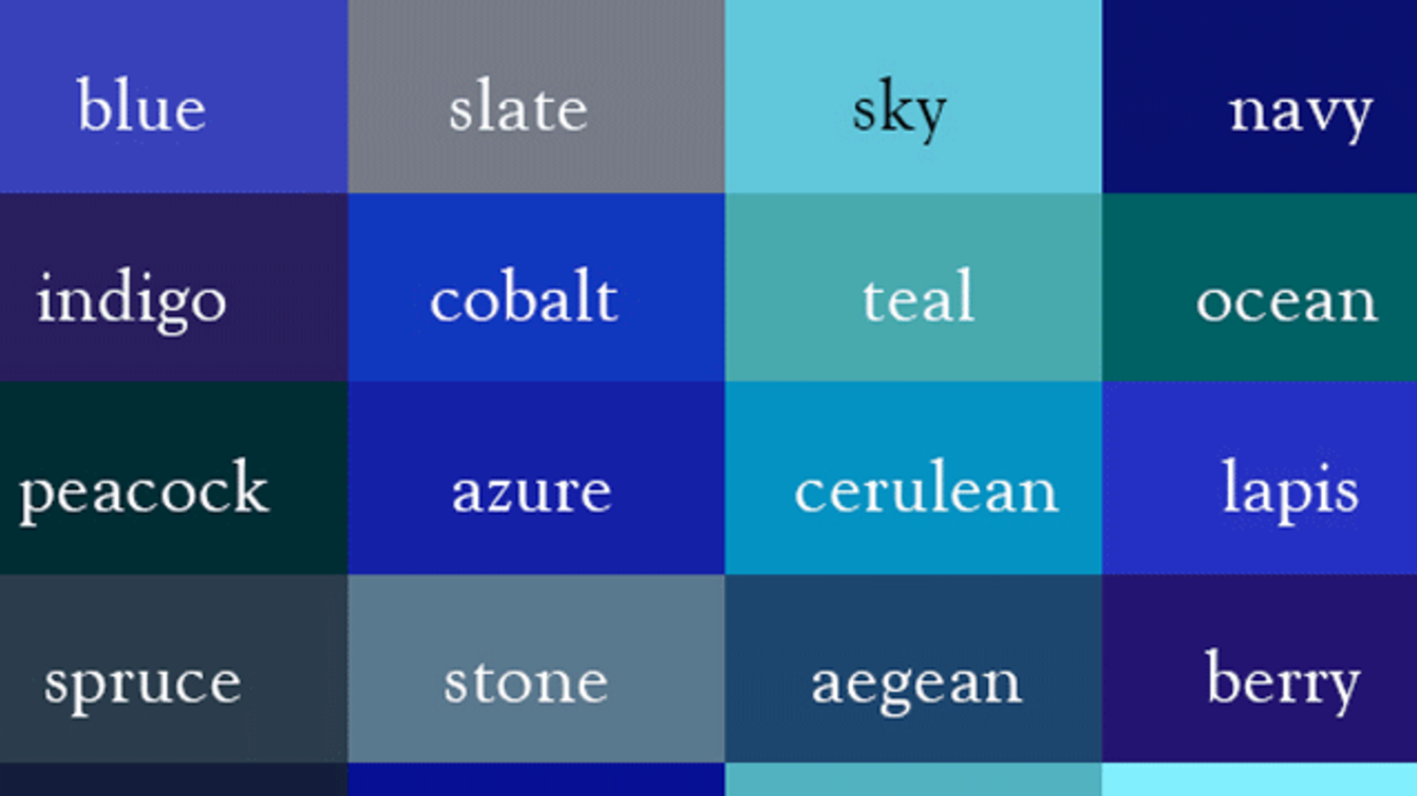
English vocabulary is largely ornamental
Basic English (Ogden, 1930): 850 words
Voice of America Word Book (1962): 1,500 words
Average adult active vocabulary (Brysbaert et al., 2016, N=221,268): 42,000 words by age 20

Slide 20
4. Life-span development resembles other sexually-selected traits
Practice before sexual maturity – like young birds ‘subsong’ before ‘crystallization’ of adult bird song
Rapid increase in communication fluency with sexual maturity
Young adult peak in verbal fluency, love poetry, courtship texting

Slide 21
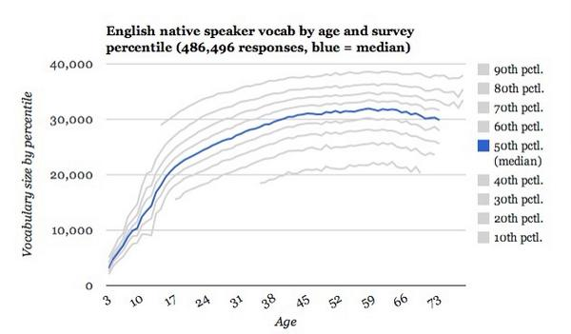
Vocabulary size across age http://testyourvocab.com/blog/
puberty
marriage

Slide 22
5: Positive heritability, & mutation load effects that reveal genetic quality
All language abilities show:
at least moderate heritability – twin & adoption studies (Stromswold, 2001 meta-analysis)
a massively polygenic basis – genome-wide association studies (GWAS) (Newbury et al., 2019)
reveal mutation load & genetic quality – genetic inbreeding studies (Fareed & Afzal, 2014)

Slide 23
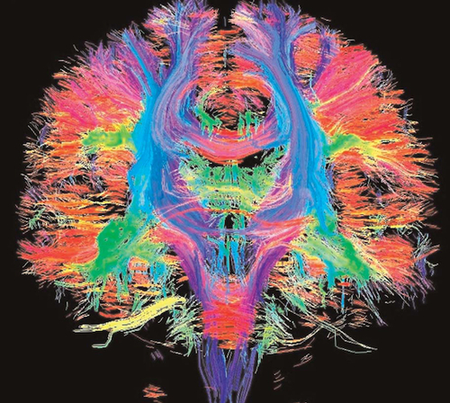
The human brain: a fitness-indicator wonderfully vulnerable to mutations
Most of the genome is expressed in the brain;
Most harmful mutations disrupt brain function somewhat

Slide 24
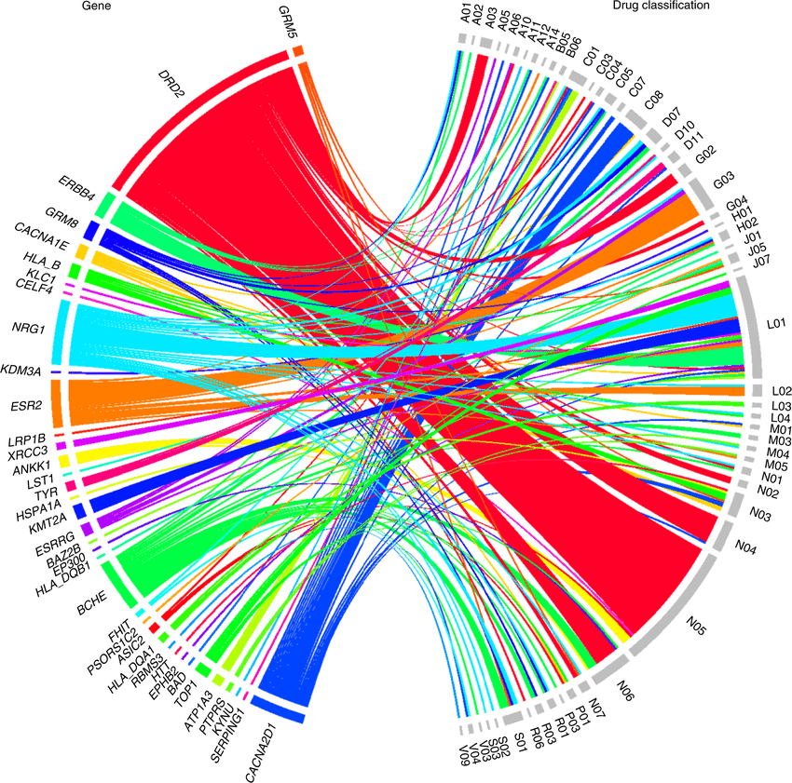
6. Positive genetic correlations with other desirable traits
Language abilities overlap with:
General intelligence – verbal intelligence has a high ‘g loading’ (Plomin & von Stumm, 2018)
Mental health – many mental disorders reduce communication abilities (Niznikiewicz et al., 2013)
Physical health – verbal abilities predict longevity (Hagenaars et al., 2016)
Chord diagram of gene interactions

Slide 25
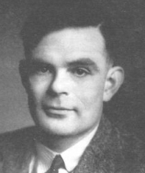
Implications for Artificial Intelligence
Turing (1950): A.I. must be able to converse like a real person:
Describe conscious experiences
Be surprising
Show a sense of humor
Attract someone fall in love with it

Slide 26
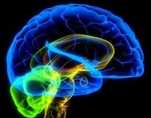
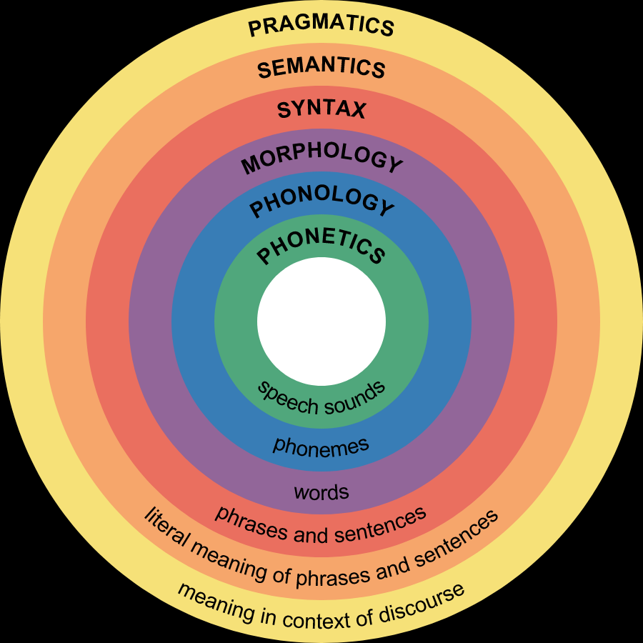
Questions?

