Slide 1
Social Media for Science Outreach: How to spread ideas, recruit students, & network with colleagues
Geoffrey Miller
Psychology Colloquium,
University of New Mexico, Aug 30, 2019

Slide 2
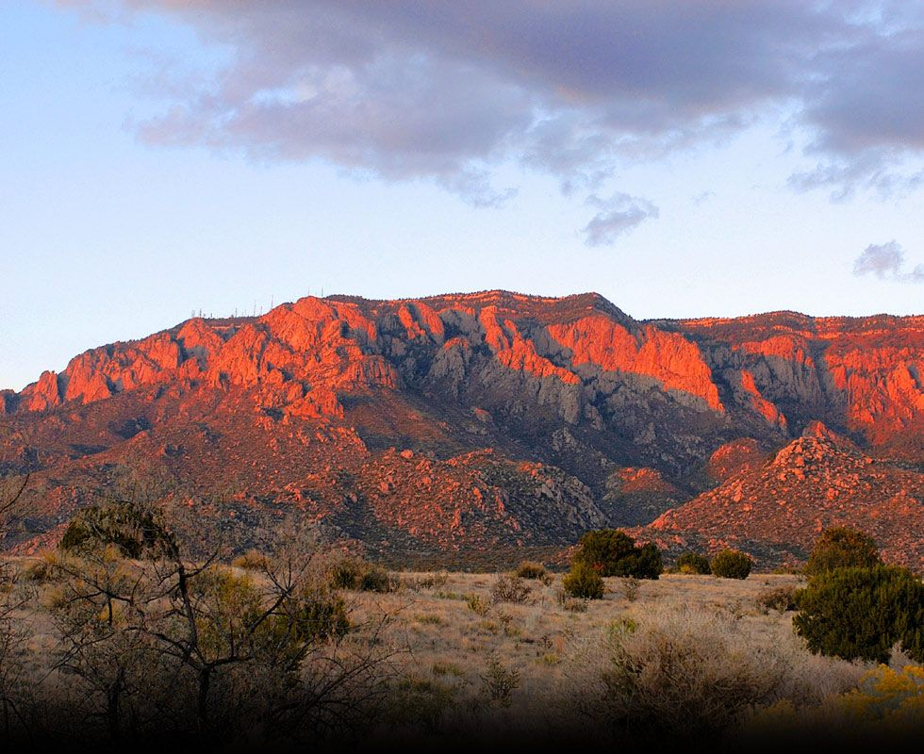
Here at University of New Mexico, we’re in the middle of a desert

Slide 3
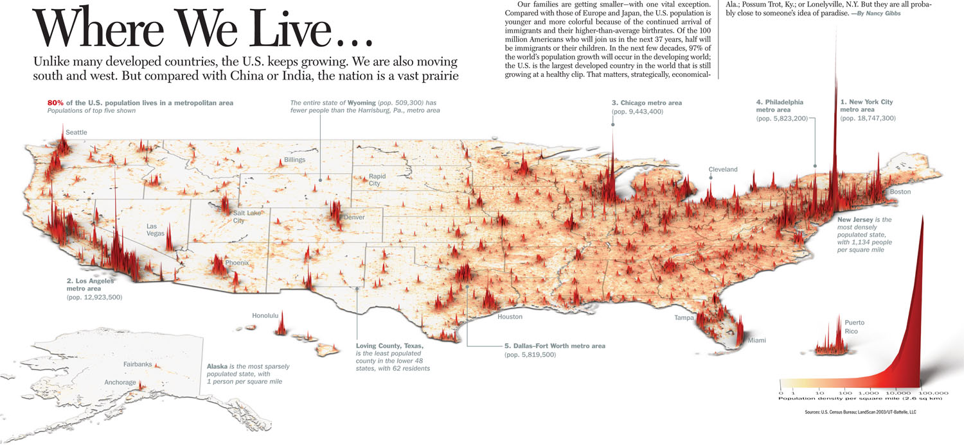
There aren’t many other people around

Slide 4
The nearest other research universities are far away
Arizona
ASU, Tempe: 410 miles
U of A, Tucson: 450 miles
Colorado
UC Boulder: 475 miles
Texas
UT Austin: 700 miles

Slide 5
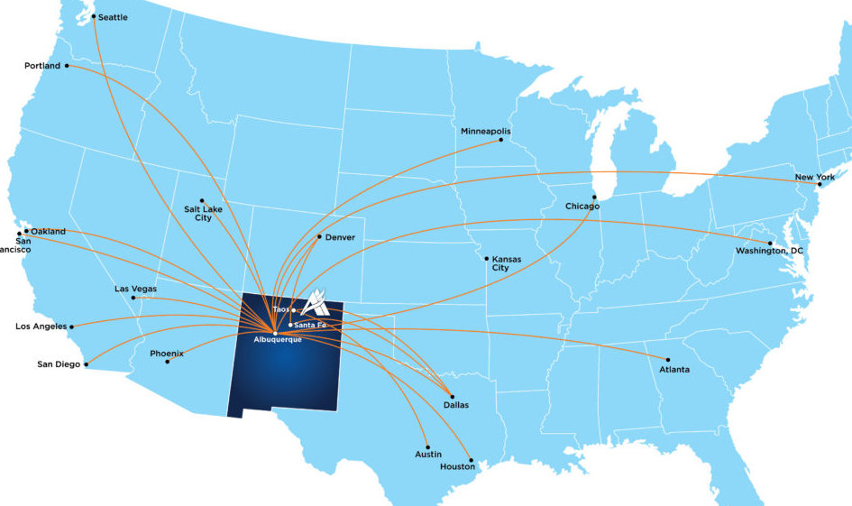
It’s hard to fly to conferences & visit colleagues (given few direct flights from ABQ)

Slide 6
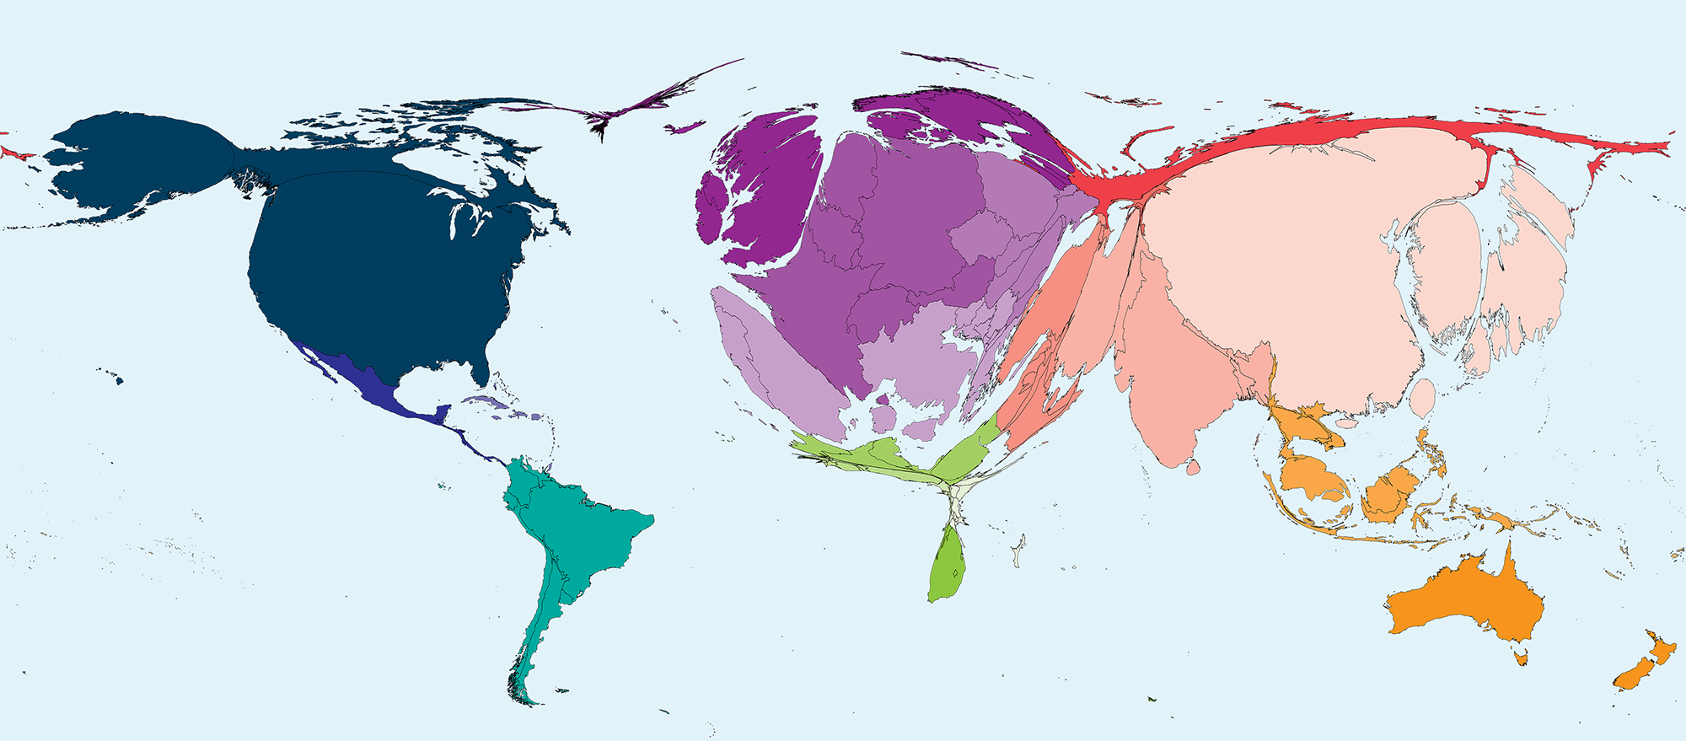
Most science happens far away (here’s country size proportional to science papers published)
www.worldmapper.com

Slide 7
But we haz fast interwebz!
2009:
4 Mbps average
2019:
UNM campus network: 900 Mbps
Xfinity at home: 900 Mbps, $100/month

Slide 8
Social media levels the playing field for scientists & students
Makes outreach, even from the desert:
Fast: Gbps, 24/7
Global: US, Europe, Asia
Cheap: ad-supported sites, freemium apps, big user base
Easy: user-friendly, simple apps, free training
Open: minimal censorship

Slide 9
tl;dr: Social media is especially useful for:
Spreading ideas, findings, theories, methods, practices
Recruiting participants, R.A.s, grad students, post-docs, faculty, clients
Networking with colleagues, journalists, companies, patrons, policy people
Finding teaching materials
Build ‘platform’ for speaking gigs, consulting work, book deals, mainstream media

Slide 10
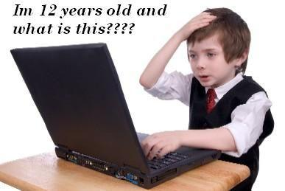
Caveats
This is my first talk about this
I’m an advanced newbie at best, with patchy knowledge
You’re busy & serious people, maybe dubious about the benefit/cost ratio of social media outreach

Slide 11
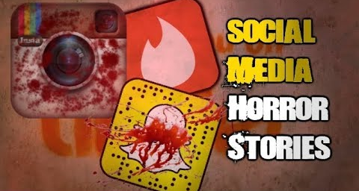
Caveats: risks & costs of social media outreach
Stress: trolls, snark, dogpiles
Opportunity costs: time, energy, money
Reputation costs: polarization, controversy, blowback, ‘cancel culture’
Hard to monetize: don’t quit your day job
Universities don’t value this as part of ‘Service’, ‘Research’, or ‘Teaching’
Habit-forming

Slide 12
Backstory 1: 3 ways to share science
Traditional: teaching, mentoring, journal papers, academic books, conference talks
Mainstream media: national TV & radio, science journalism, trade books, public lectures
Social media: today
See https://youtu.be/mRHFtUoywEI

Slide 13
Social media ‘platform’ is crucial now even for mainstream media outreach
Without social media influence,
Publishers won’t give you a book deal
National TV & radio won’t interview you
Science journalists won’t email you
Science festivals won’t invite you to give public lectures
Companies won’t hire you for consulting
Clients won’t trust your clinical interventions

Slide 14
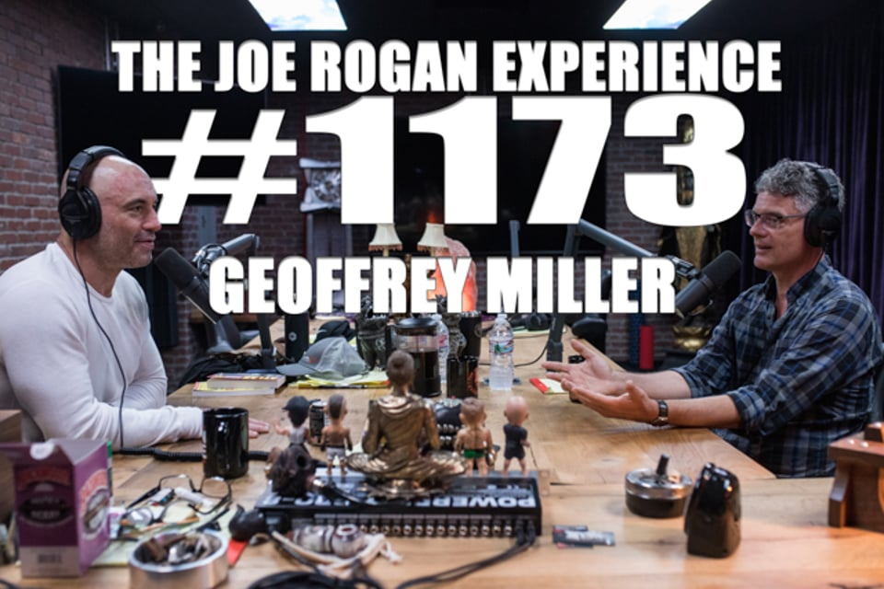
Backstory 2: Joe Rogan interview
3-hour interview Sept 2018
YouTube: 1,020,000 views
Around 1 million hours viewing time
Taught 18 years at UNM: 4 classes/year, 40 students/class, 40 contact-hours/class = 115,200 contact-hours total
One YouTube video had 9 times the viewing time of all classes I’ve ever taught
https://www.youtube.com/watch?v=3MWvDgdRWQ4

Slide 15
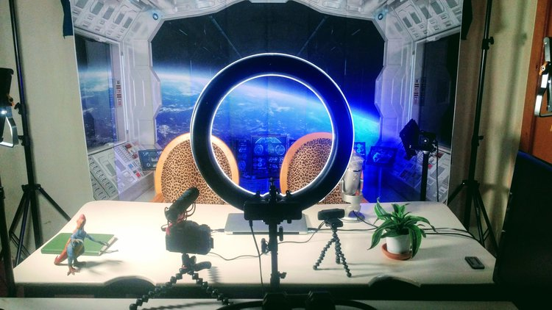
Backstory 3: What I did on my summer vacation
Housemates Justin (political scientist), Aria (writer), Diana (ev psych) + Ben (tech guy)
Set up home YouTube studio: cameras, lights, teleprompter, mics, mixer, backdrops
Launched YouTube channel (20+ videos, 2k subscribers)
Updated & integrated all social media accounts & website
Self-publishing 5 ebooks

Slide 16
How do other researchers, students, clients, patrons, & science journalists really learn about your stuff?
Reading physical journals?
Doing lit reviews?
Seeing conference talks?
Browsing university websites?
Googling your research keywords?
Word of mouth based on other people doing these things?

Slide 17
Social media sites most relevant for American researchers
Arranged by monthly active users (MAUs)
Facebook (2.2bn): family, friends, colleagues, students, groups
YouTube (1.9bn): videos, livestreams, interviews
Twitter (330m): short messages, polls, & links
LinkedIn (290m): corporate jobs, consulting

Slide 18
Less relevant
WhatsApp (1.5bn MAUs): messaging
Messenger (1.3bn): messaging
Instagram (1bn): images
Tumblr (640m): images
Snapchat (250m): messaging
Chinese apps: WeChat (1.1bn), QQ (800m), Qzone (630m), Tik Tok (500m), Sina Weibo (390m), Baidu Tieba (300m)

Slide 19
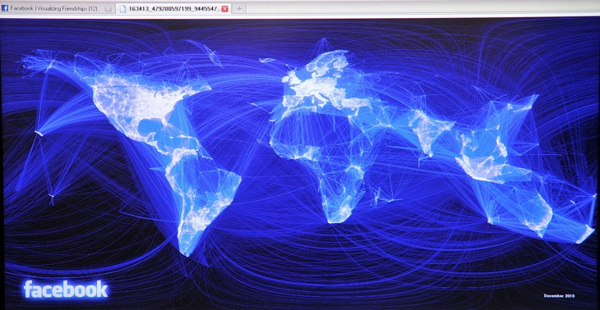
Facebook
Monthly active users: 2.2 billion
Useful to have a profile with work & education, contact info, details
Useful to make ‘friends’ with colleagues
‘Groups’ are most useful for reaching large numbers:
Recruiting participants, grad students, faculty, clients
Sharing papers, interviews, videos, conference announcements

Slide 20
Facebook Groups: The key gateway
Groups I’m in, for example:
Evolutionary Psychology: 41k members
Positive Psychology: 23k
Effective Altruism: 17k
APA: 13k
Quillette Circle: 4k
APA Div 44: Consensual Non-Monogamy Task Force: 950 likes

Slide 21
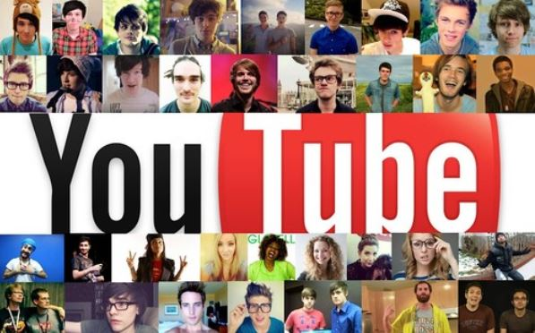
YouTube
Monthly active users: 1.9 billion
37% of all mobile web traffic worldwide
Teaching resource for finding videos, interviews, behavior examples, current affairs links
Learning resource for keeping up, exploring related fields, getting practical skills
Outreach resource for finding like-minded journalists, podcasters, YouTubers to interview you
Fairly easy to set up your own station and upload videos

Slide 22
YouTube can be very high impact
PewDiePie (gaming): 100m subscribers, 23bn views
Jordan Peterson (psych): 2.2m subs, 115m views
BrainCraft w. Vanessa Hill (psych): 470k subs, 29m views
But even modest impact can increase your impact, citations, recruitment, network, consulting, credibility, book advances

Slide 23
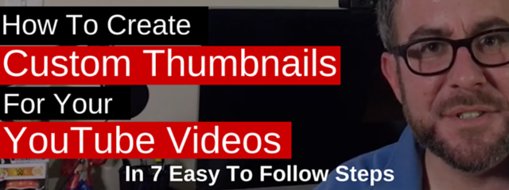
YouTube Channels
Easy to set up with Google account
Lots of guidance from other YouTubers
Shoot videos: If you can do video skype calls, you can record YouTube videos
Edit videos: YouTube native editor, or Adobe Premier Pro (free with UNM Creative Cloud)
Upload videos: title, description, keywords, thumbnail
Promote videos: other social media sites, friends, followers

Slide 24
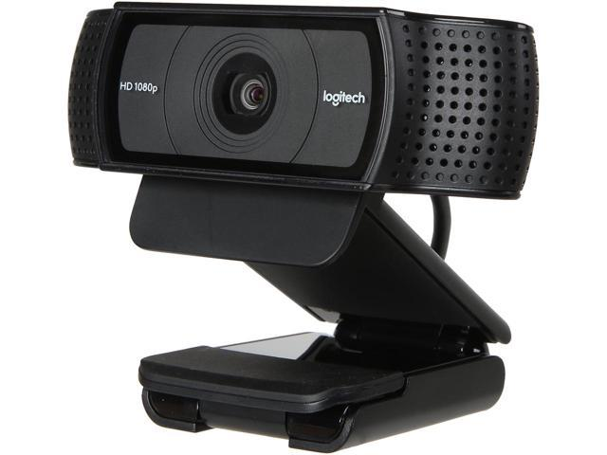
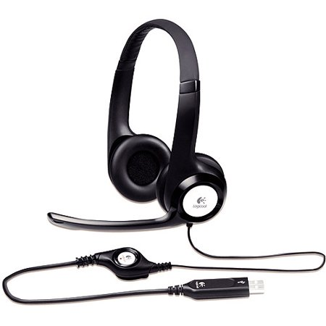
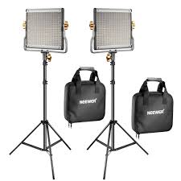
YouTubing got so popular, equipment got cheap (Amazon)
Camera:
Logitech HD webcam $80
Lumix G7 $500
Microphone
Logitech H390 $23
Blue Yeti $110
Lights
Neewer LED light kit $130
See https://www.primalpoly.com/studio-equipment

Slide 25
Low-hanging fruit: short videos (c. 3 mins)
‘Video abstracts’ about new papers
‘Course trailers’ for undergrad classes
‘Welcome messages’ on website
‘Lab intros’ for potential grad students

Slide 26
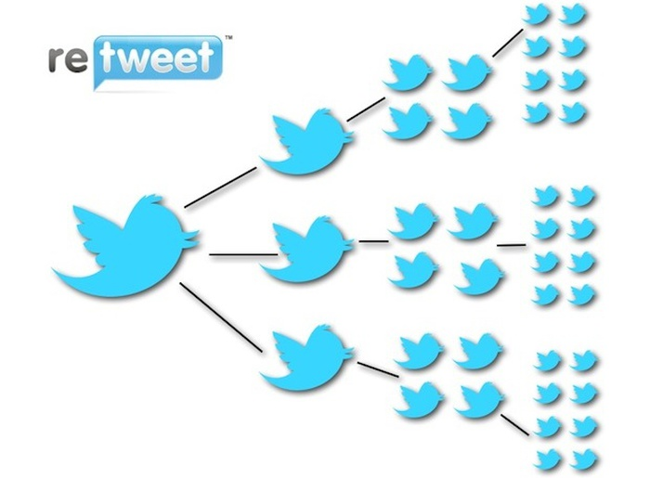
Twitter
Monthly active users: 330 million
Why be on Twitter? Because everyone influential is on Twitter
journalists, bloggers, podcasters, educators, authors, rich patrons, policy wonks, politicians
‘Science Twitter’ is very active
Downsides: polarized, partisan, many trolls, often nasty
Takes a long time to build a big following, but even a small following can yield big retweets

Slide 27
LinkedIn
Monthly active users: 290 million
Favored by companies, corporate people, consultants
Useful to have a profile with description, experience, education, skills, contact info – credibility-indicators
Pretty dull; not so useful to add ‘connections’ or post stuff
But can yield consulting work, speaking gigs, collaborations

Slide 28
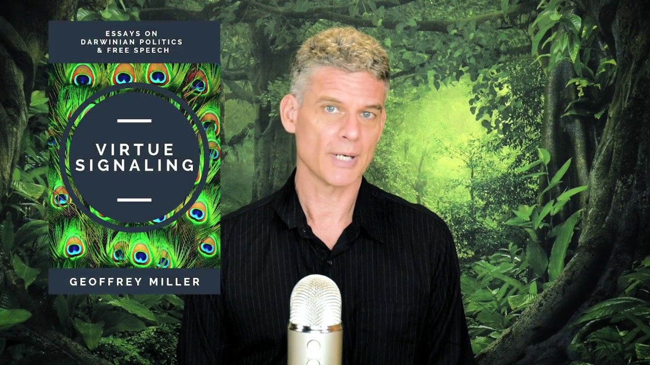
Personal website
www.primalpoly.com
Designed/hosted by www.squarespace.com, c. $12-18/month; easy to design (no coding)
Stuff on my personal website that’s not on my UNM site:
Welcome video
Links to all interviews, podcasts, videos, talks
Book details: descriptions, blurbs, reviews
Research overview, all publications, talks given, students, collaborators, courses, syllabi
Consulting experience & interests
Recommendations: books, movies, equipment

Slide 29
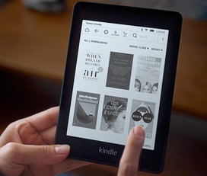
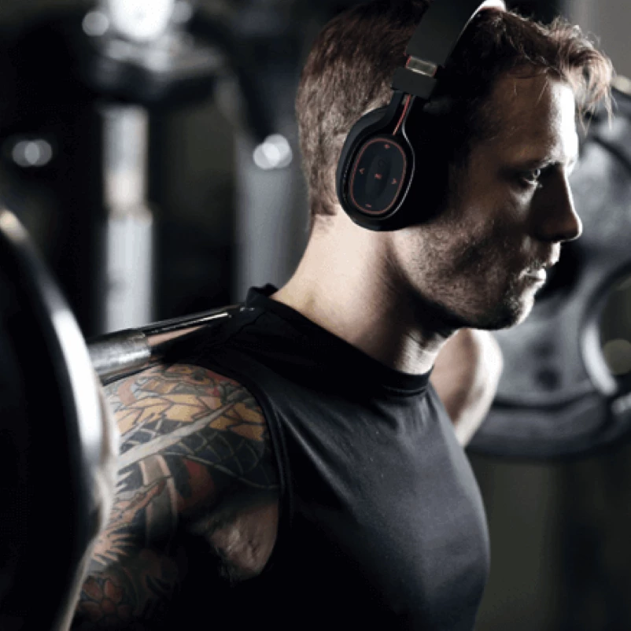
Other digital outreach: new ways to consume information
ebooks
Podcasts

Slide 30
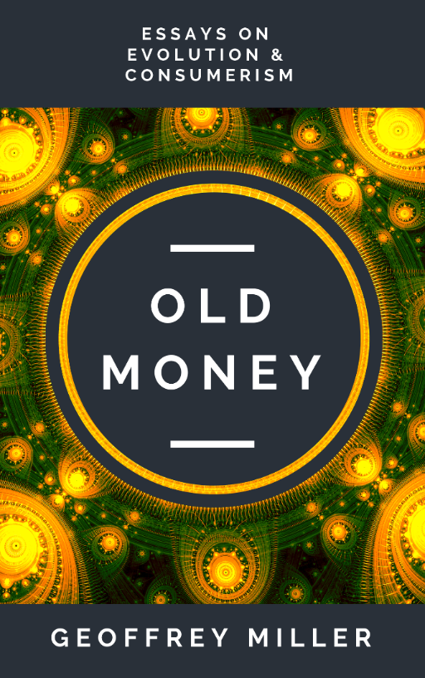
Covers from my new ebook series

Slide 31
Self-publishing ebooks
Fast, simple, helpful income stream
Text: Gather content, edit, write preface
Formatting: .pdf, .epub, .mobi versions
Title: test options with Twitter polls
Design cover: Canva design site, Dreamstime stock photo service, test prototype designs
Legal: buy ISBNs from Bowker
Distribution: Gumroad (92% royalty), Amazon KDP (60%) – vs. 15% traditional publishing
Promote through social media, podcasts, interviews, online magazines

Slide 32
What you can write ebooks about
Ideal length: 100 pages, $5-7 retail
Collect existing essays & accessible writings
Text versions of course lectures & conference talks
How-to guides to specific psych research methods, stats, datasets, therapies (charge $50 rather than $5)
Anything that might be helpful to students, clients, younger researchers, journalists, policy wonks, general public

Slide 33
The Podcast Revolution
People tired of radio & streaming music
Want to listen while driving to work, exercising, doing hobbies, watching kids
Mostly through smartphones & car audio
22% of Americans (60m) listen to podcasts at least weekly,
Mostly aged 20-50, educated, professional, equal sex ratio
https://www.convinceandconvert.com/podcast-research/2019-podcast-statistics/

Slide 34
Examples of popular psychology podcasts
Speaking of Psychology (APA news)
All in the Mind (BBC)
Hidden Brain (NPR)
Waking Up (Sam Harris)
Psychology Podcast (Scott Barry Kaufman)
Psych Central (mental disorders)

Slide 35
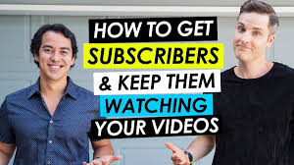
Social Media world can be nasty, but is also mutually supportive – especially among scientists
Many YouTubers and podcasters looking for new people & content
Social norm of reciprocity for interview time, promotion links, advice-giving
Willingness to mentor newbies
huge number of YouTube videos on how to set up studio & channel, how to film & edit videos, how to promote & monetize
e.g. Video Influencers, Peter McKinnon, DSLR Video Shooter

Slide 36
Tech transitions you’ve already faced if you’re senior faculty
Landlines → Smartphones & Skype
Libraries & Xerox machines → Google Scholar & pdfs
Show of hands → iClickers
Overhead projectors → Powerpoint
Filofax → Google Calendar
Conference maps → Google Maps
Excel → SPSS & R
CT scans → NIRS imaging
Twin studies → genomic heritability

Slide 37
Resources for later
This Powerpoint is posted on https://www.primalpoly.com/talk-powerpoints
My social media accounts are all at https://www.primalpoly.com/contact
Studio equipment recommendations at https://www.primalpoly.com/studio-equipment
YouTube channel at https://www.youtube.com/geoffreymillerphd
Happy to help anybody with advice, videos, podcasts, interviews, ebooks, etc.

Slide 38
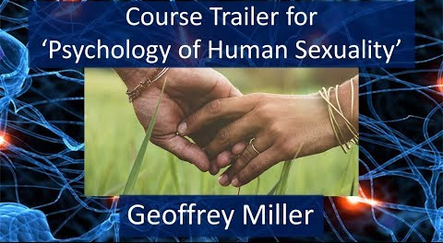
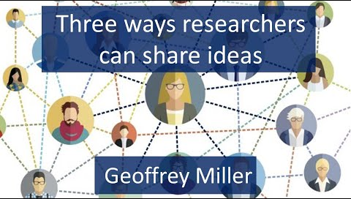
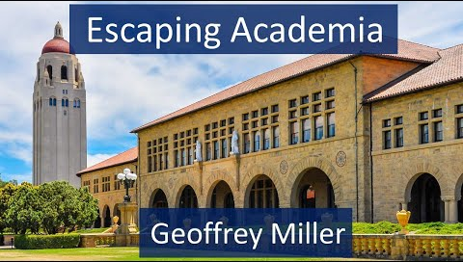
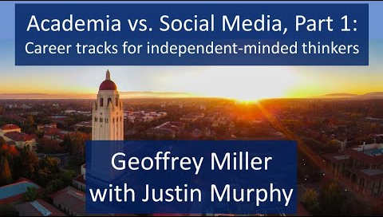
Related videos on my YouTube channel
Course trailer for sexuality class (3 mins): https://youtu.be/nb13nV_SGcA
Three ways researchers can share ideas (7 mins): https://youtu.be/mRHFtUoywEI
Escaping Academia (53 mins): https://youtu.be/icnwZmoW19w
Academia v. social media (Part 1, 30 mins): https://youtu.be/Lzg4_WQxLdA
Academia v. social media (Part 2, 77 mins): https://youtu.be/mrd1EkFSnsA

Slide 39
Questions?

